Slide 1
CNENGR227 – Electromagnetics, Semiconductors and RF Engineering Lab 1: Spectrum Analysis
Dr Harry Marks

Slide 2
Learning objectives
This lab aims to teach you about spectrum analysis.
You begin by modelling a mixer and a filter.
You will look at how a waveform is transformed into its spectral components.
This practical will use Matlab to gain more experience with this powerful tool.
Record your results, save your Matlab code and figures generated. These results will got into Part 1 of a report you will submit at the end of week 8.

Slide 3
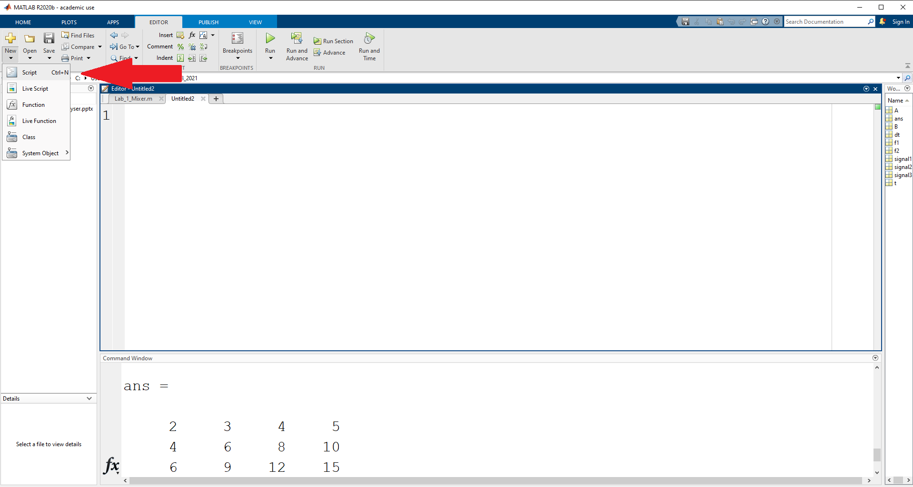
Getting Started in Matlab: After opening Matlab click “New”, and then click on “Script”.

Slide 4
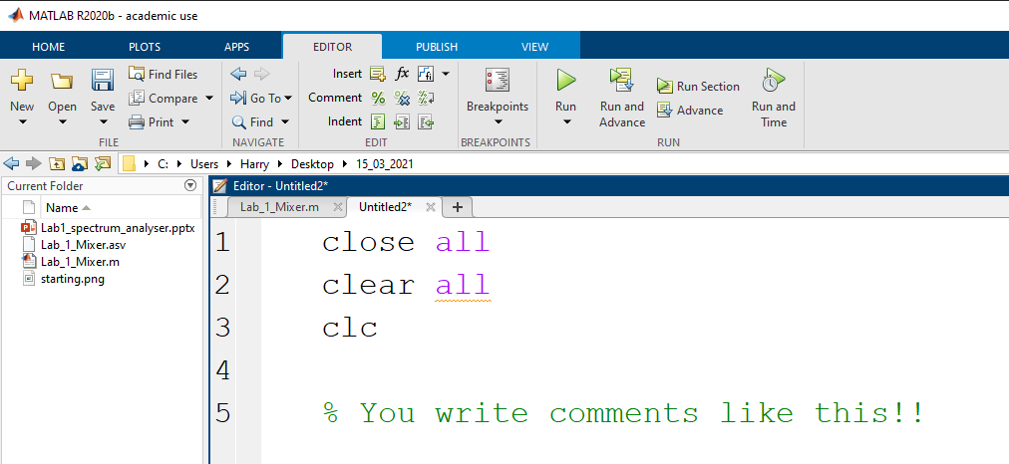
Notes on Matlab
It’s a good idea to start each program by writing:
This closes any open figures, removes any old variables from the program’s memory, and clears the output window.

Slide 5
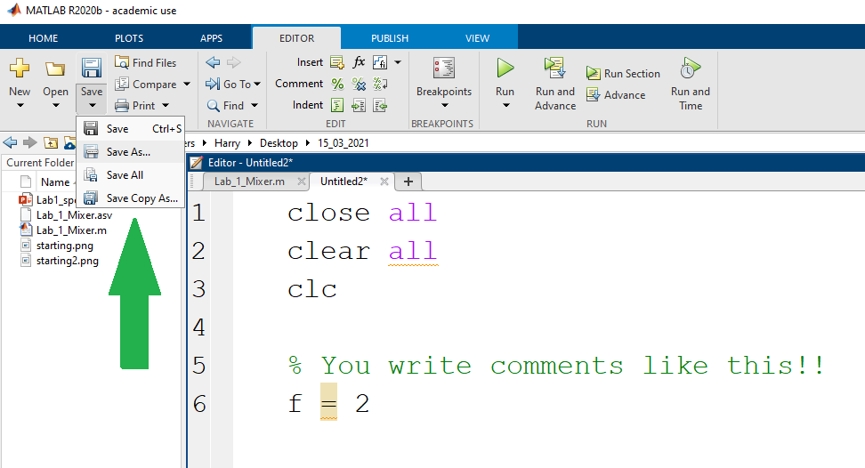
Before running your program for the first time you must save it to the computer hard disk.

Slide 6
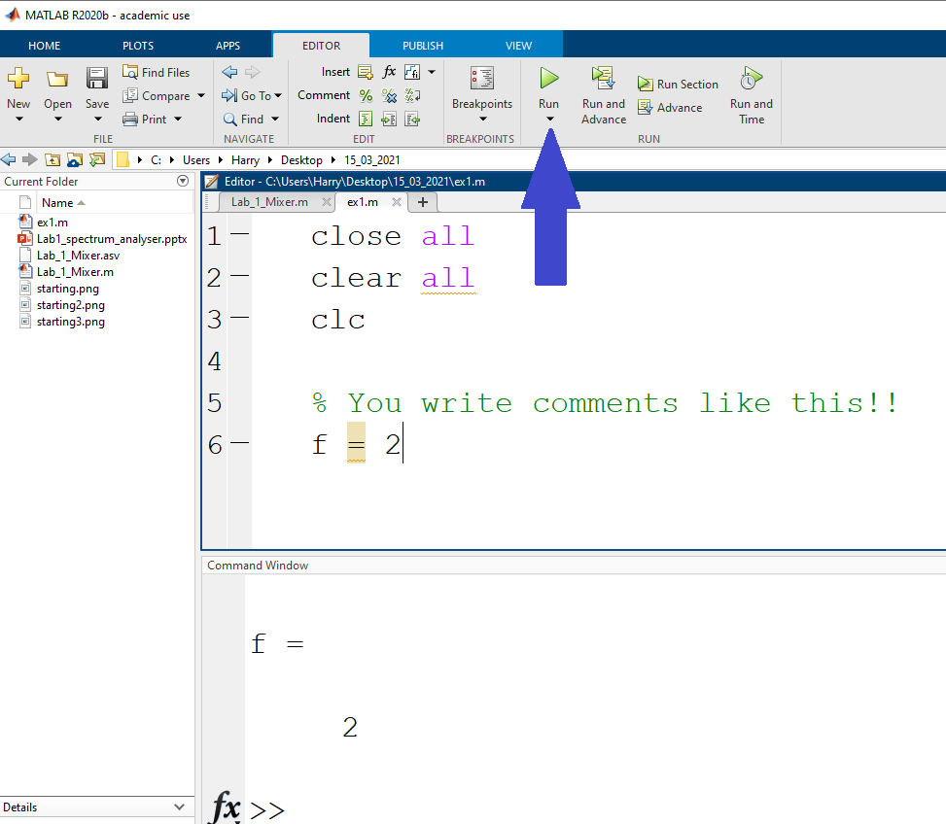
Click the green play button to run the program: The output appears in the command window.

Slide 7
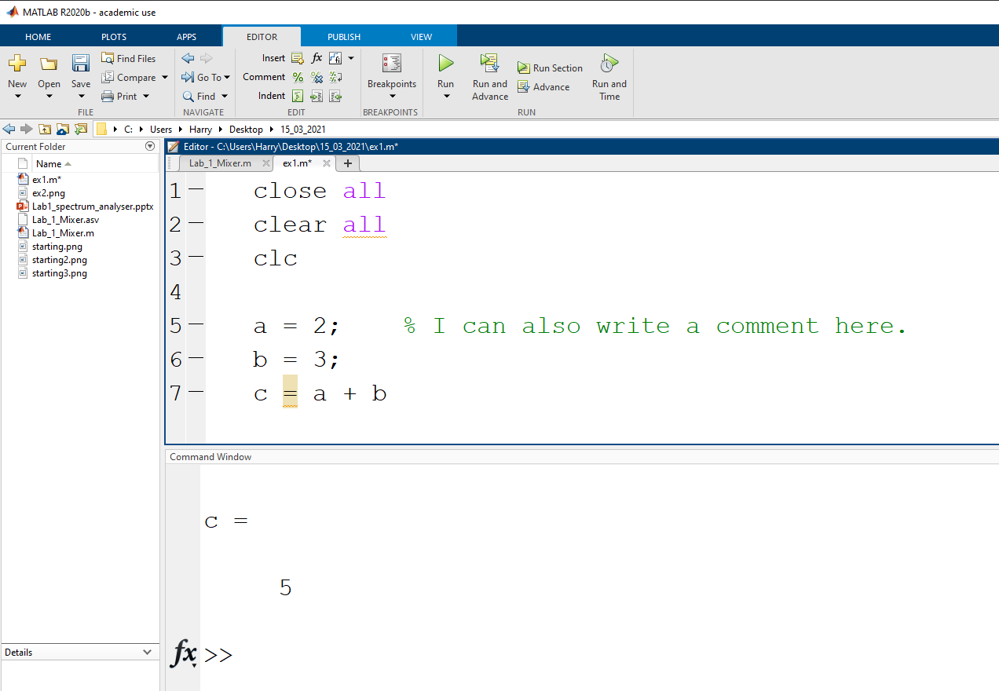
After running this program the only output is the variable “c”. Put semi-colons “;” after lines of code for which you don’t want the output.

Slide 8
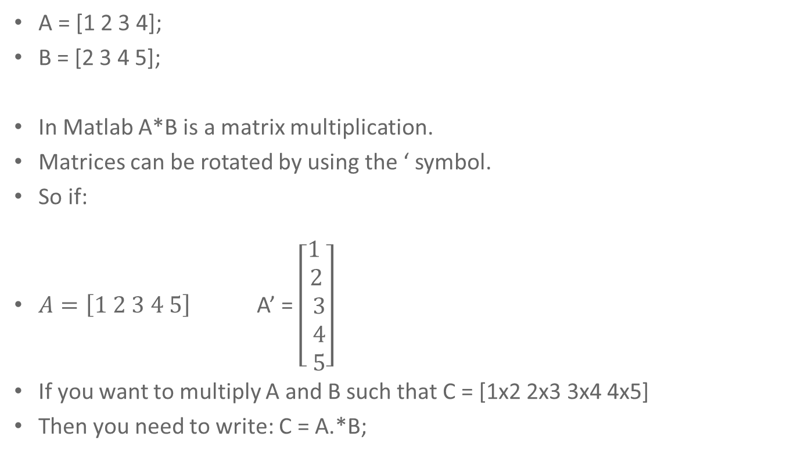
Multiplication in Matlab
A = [1 2 3 4];
B = [2 3 4 5];
In Matlab A*B is a matrix multiplication.
Matrices can be rotated by using the ‘ symbol.
So if:
$A=\left[1 2 3 4 5\right]$ A’ = $\left[\begin{aligned}1 \\ 2 \\ 3 \\ 4 \\ 5\end{aligned}\right]$
If you want to multiply A and B such that C = [1x2 2x3 3x4 4x5]
Then you need to write: C = A.*B;

Slide 9
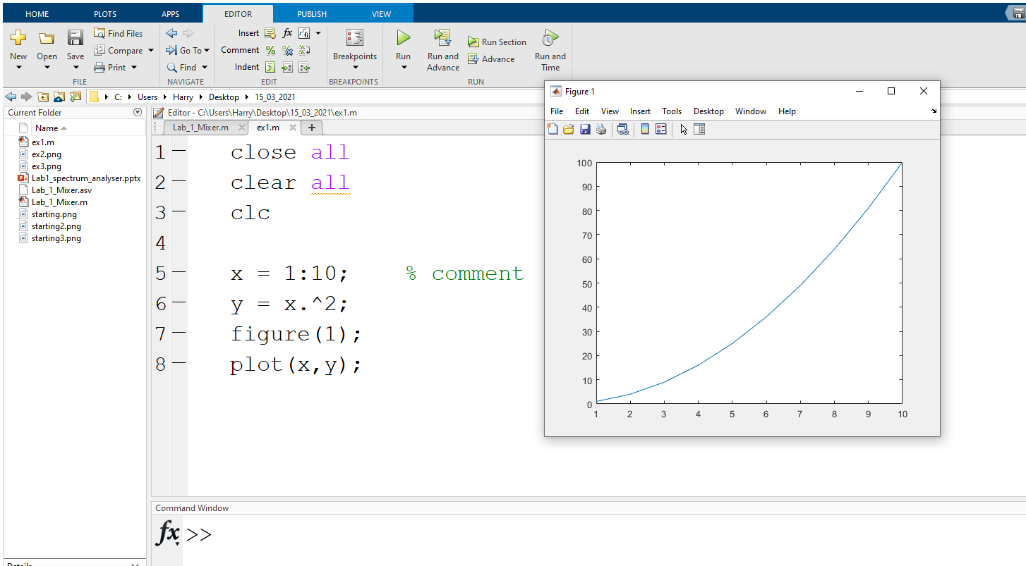

Plotting a figure in Matlab. Graph of $$y=x^{2}$$ Note the dot before the ^.

Slide 10
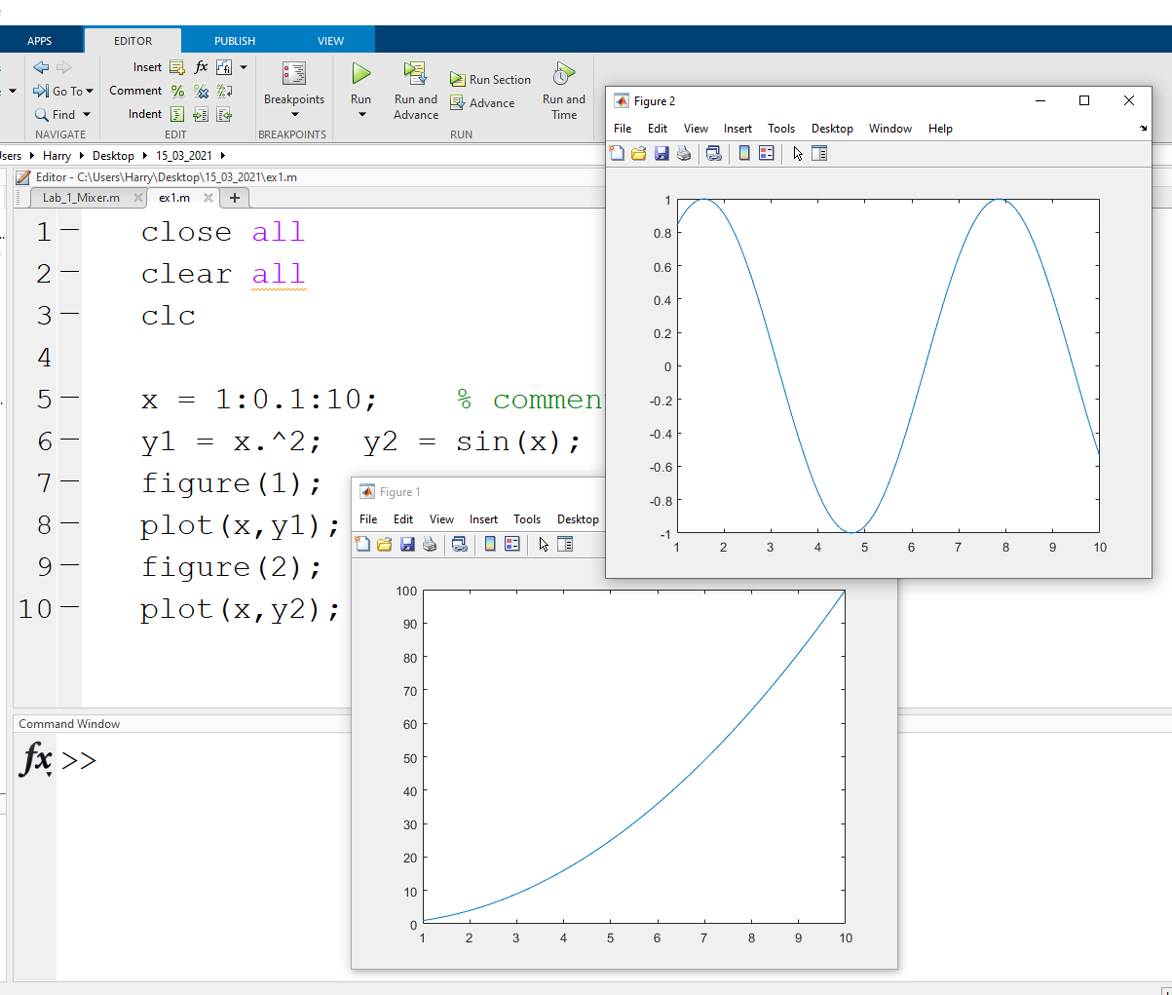
Plotting two figures. Figure 2 is sin(x).

Slide 11
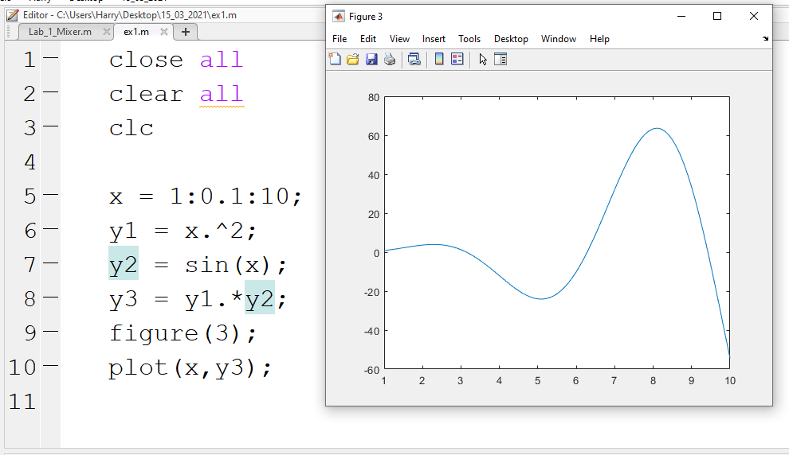

Slide 12
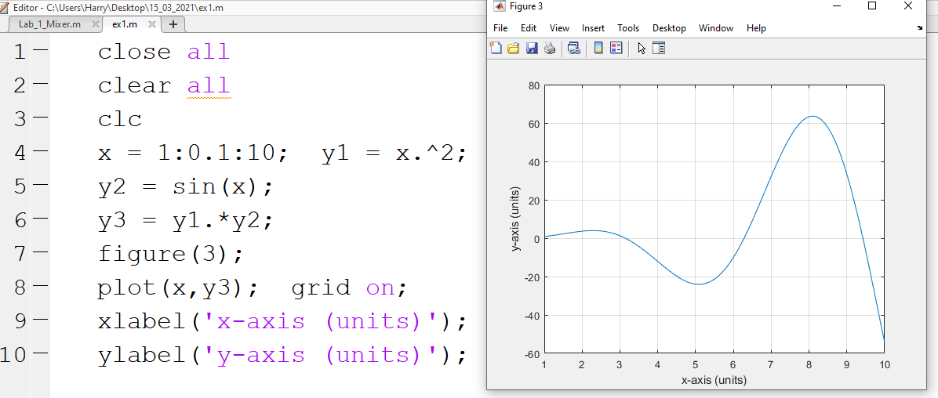
Switching on grid lines and labelling the axes.

Slide 13
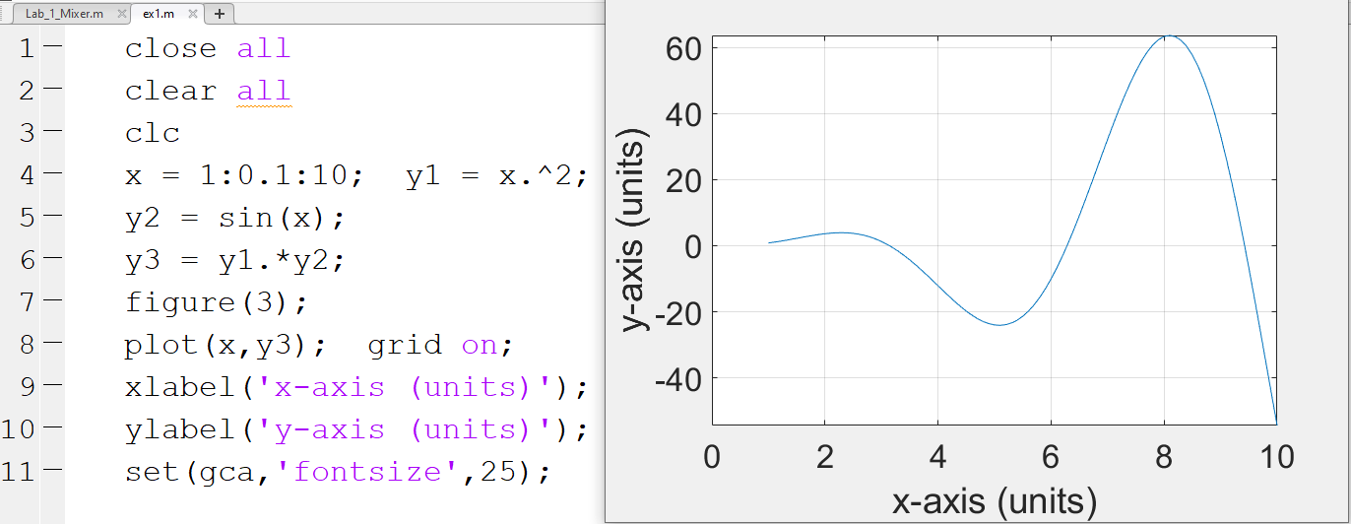
Adding a command (line 11) to increase the font size.

Slide 14
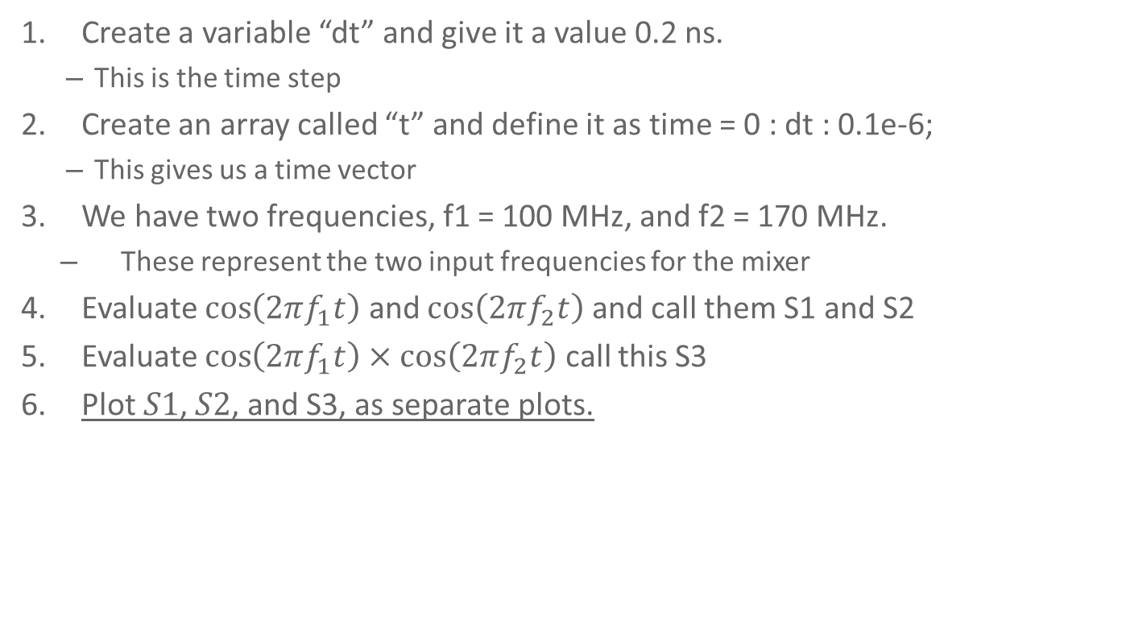
Instructions for the Mixer Task (1)
Create a variable “dt” and give it a value 0.2 ns.
This is the time step
Create an array called “t” and define it as time = 0 : dt : 0.1e-6;
This gives us a time vector
We have two frequencies, f1 = 100 MHz, and f2 = 170 MHz.
These represent the two input frequencies for the mixer
Evaluate $\cos\left(2πf_{1}t\right)$ and $\cos\left(2πf_{2}t\right)$ and call them S1 and S2
Evaluate $\cos\left(2πf_{1}t\right)×\cos\left(2πf_{2}t\right)$ call this S3
Plot $S1$, $S2$, and S3, as separate plots.

Slide 15
Take the Fourier Transform of the three signals generated.
Hint: You may find it useful to use the example code below for the Fourier Transform. Take some time to understand the commands.
time_between_samples = (t(end)-t(1))/length(t);
sampling_frequency = 1/time_between_samples
fft_b = fft(S3);
x1 = -floor(length(t)/2):floor(length(t)/2);
df1 = sampling_frequency1/length(x1);
figure(8);
EV = (ifftshift(abs(fft_b)))./(length(x1)/2);
plot((x1-1)*df1./1e6, EV ); set(gca,'fontsize',24);
grid on; xlabel('Frequency (MHz)');

Slide 16
Some Tips:
When you are unsure about a command in Matlab you can type “help” into the command line followed by the command, and Matlab will describe the use of the function, for example:
help floor
“floor(X) rounds the elements of X to the nearest integers
towards minus infinity.”
The length of a vector can be checked using the length command.
For instance “length(x1)”.
To present more clearly after the plot command the following command can be used to only show a certain region of the plot.
axis([0 500 0 1]);

Slide 17
Task (2)
Plot on three separate figures the Fourier Transforms of S1, S2, and S3.

Slide 18
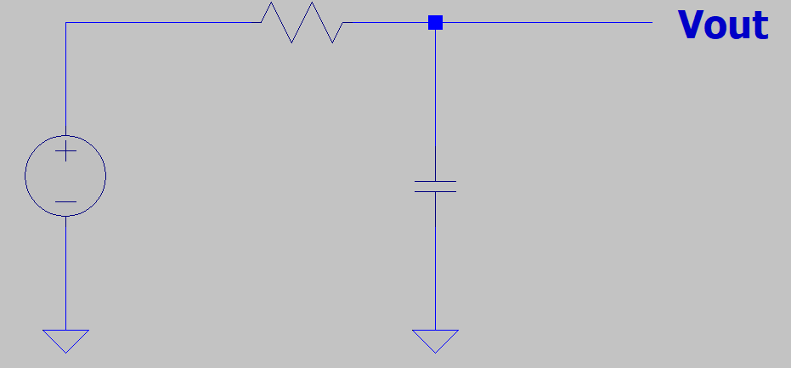
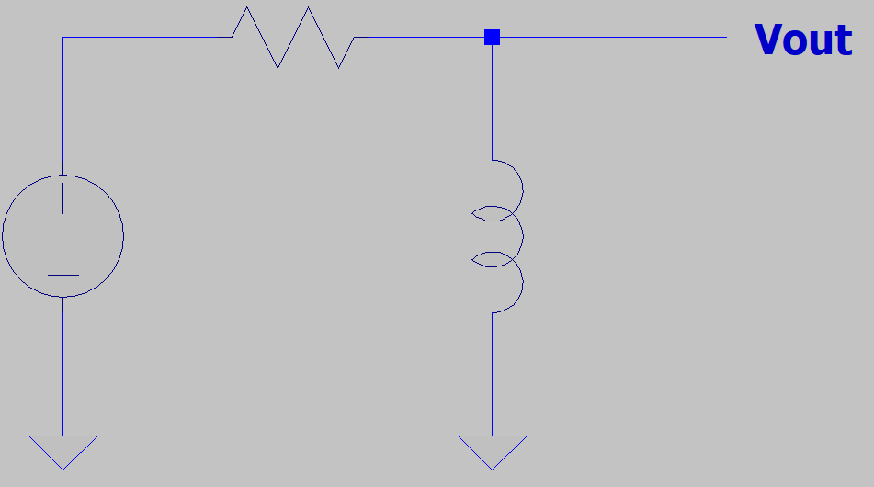
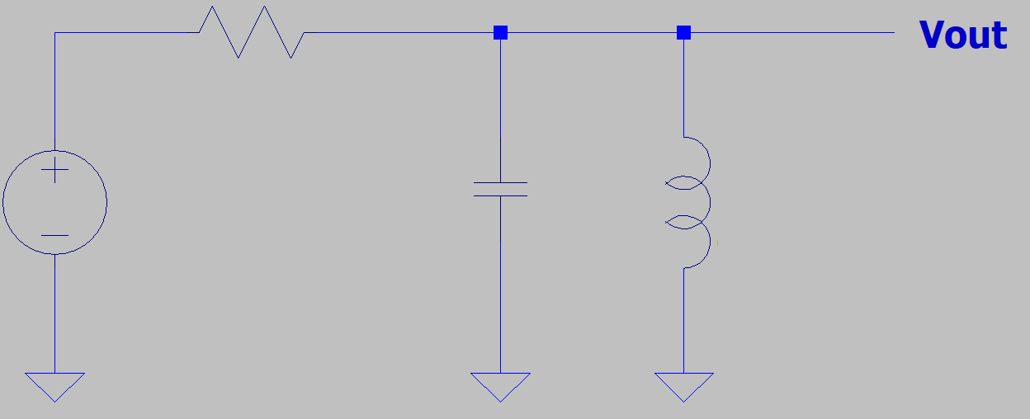
Derive the Transfer Functions (Vout/Vin) for the following circuits as a function of frequency: R = 50 Ω, C = 25 pF, L = 0.05 µH

Slide 19
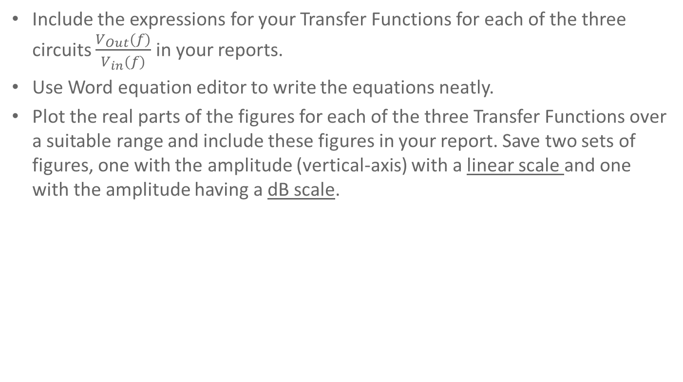
Task (3)
Include the expressions for your Transfer Functions for each of the three circuits $\frac{V_{Out}(f)}{V_{in}(f)}$ in your reports.
Use Word equation editor to write the equations neatly.
Plot the real parts of the figures for each of the three Transfer Functions over a suitable range and include these figures in your report. Save two sets of figures, one with the amplitude (vertical-axis) with a linear scale and one with the amplitude having a dB scale.

Slide 20
Guidelines on how to present your work:
The results of this lab should be written up in Word.
Equation editor should be used to write down the equations.
For the figures:
Choose appropriate font sizes.
Label the horizontal and vertical axes appropriately.
Include units in the labels.
20% of the marks for this report will be on the overall presentation.

Slide 21
Task 4: Ring Diode Mixer
Using LT Spice build a ring diode mixer circuit and show on separate graphs the output of the IF, LO, and RF and any other parts of the circuit which you think may be interesting to probe.
Suggested values: For inductive coils 0.6 mH. For frequencies, let L0 = 130 kHz, RF = 125 kHz.
Remember to include a low pass filter at the IF port of your circuit.

Slide 22
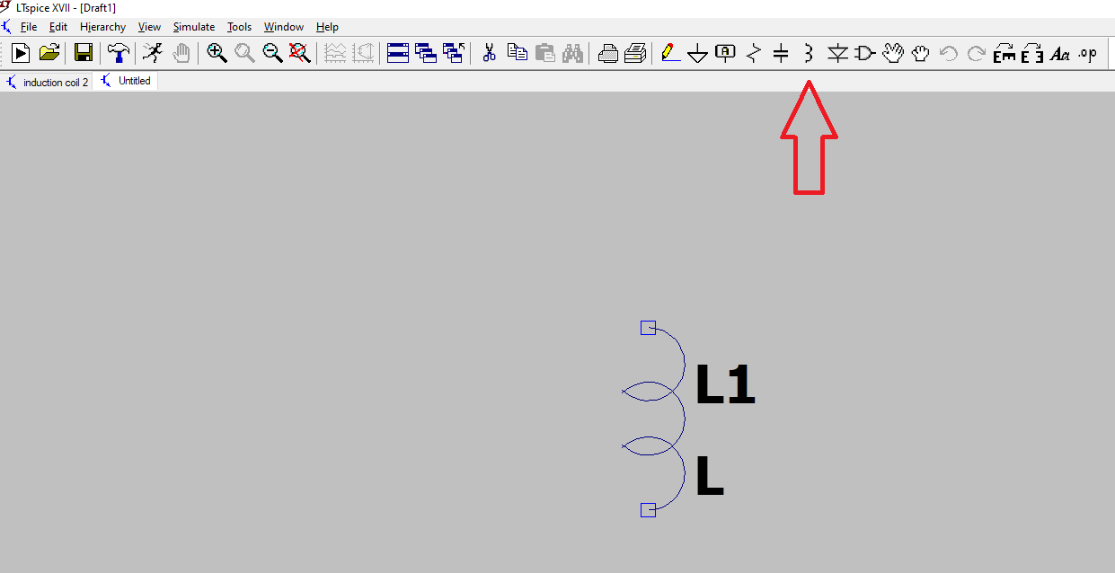
Open LT Spice – Insert an inductor

Slide 23
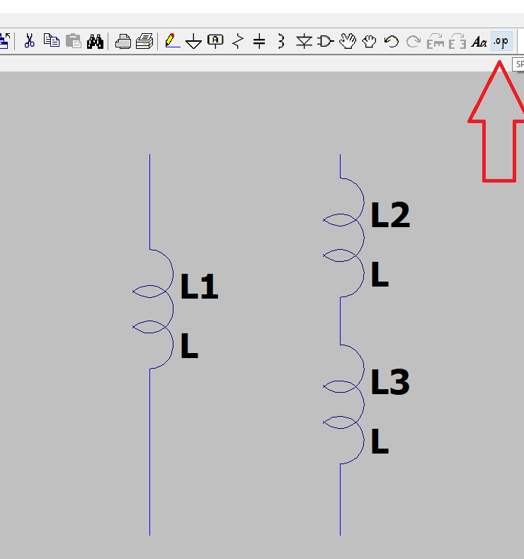
Insert two more inductors. We don’t have a wire connecting them. The coils are inductively linked. Click on “Spice Directive” as shown with the arrow.

Slide 24
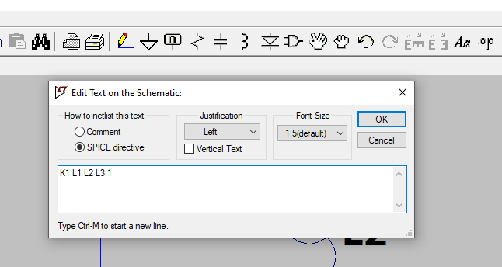
Type “K1” to name the first connection. Followed by the names of the coils to be inductively coupled. Finally the number “1” is to signify ideal coupling.
When putting in the RF Balun type “K2” etc.

